Slide 1
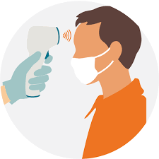
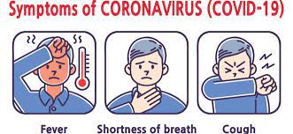
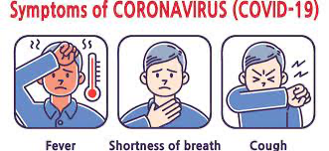
Covid-19 Symptom Checker
By: Cameron Dyas, Reshma Luke and Elijah Judge

Slide 2
Table of Contents
Introduction
Data Pre-Processing
Data Extraction, Data Transformation, Data Cleaning and Training Phase
MapReduce Algorithm
Map Phase, Reduce Phase and Results
Failures, Conclusions, and Improvements

Slide 3
Introduction
COVID-19 is an infectious disease that has caused a pandemic and hysteria throughout the world
An individual affected with COVID-19 generally witnesses mild issues but it mostly depends on an individual’s age and if they are affected with past diseases or illnesses such as cancer, diabetes, and heart problems.
The object of this identify who is more susceptible to COVID-19 and to take steps to protect them using data science.
Notes:
@Elijah I’m gonna remove the part in the green in you don’t mind cause i think we just have to introduce our topic!
Data is considered large when it requires more than one computer to be processed; this is where our map reduce function comes into play.

Slide 4


Data Extraction/Scraping
Extracted a binary data set
Consisted of symptoms at the headers
Values filled with 1 for yes they have the symptom or 0 if no they don’t.
In hindsight this data was not ideal since it led to overfitting of our model.

Slide 5
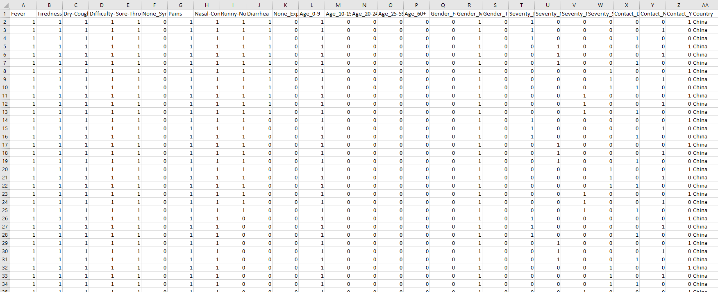
Figure 1: COVID-19 Data Set

Slide 6
COVID-19 Data Set Cont.
The data set in figure 1 was the original set we got from kaggle
It is a binary data set consisting of values of either 1 or 0
Shows information of a patient’s country, age, and gender which are considered the objective features
Also shows subjective features like fever, tiredness, Dry-cough, etc.

Slide 7
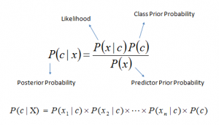
Hypothesis
Our original hypothesis after extracting the data set in the previous slide was to use the Naive Bayes algorithm to determine the probability of each covid symptom leading to a positive case of covid. Originally we thought that the Severity_none, Severity_mild… etc were labels, leading us to believe that we were looking at a set for a supervised machine learning algorithm.

Slide 8
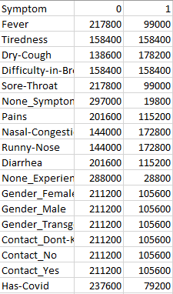
COVID-19 Data Set Transforming
From our data set our original hypothesis was to implement the Naive Bayes algorithm
The has-covid row was all the Severities besides none grouped since they all had the same amounts of nos and yeses. We later learned that this meant that we should've gotten rid of the all the irrelevant attributes we found and implemented an unsupervised machine learning algorithm.
The image on the right is our original attempt at formatting our data set into something
we could use with the Naive bayes supervised learning with Has-Covid as its label.
We used python to transform the Figure 1 Data set into the image on the right.
Figure 3

Slide 9
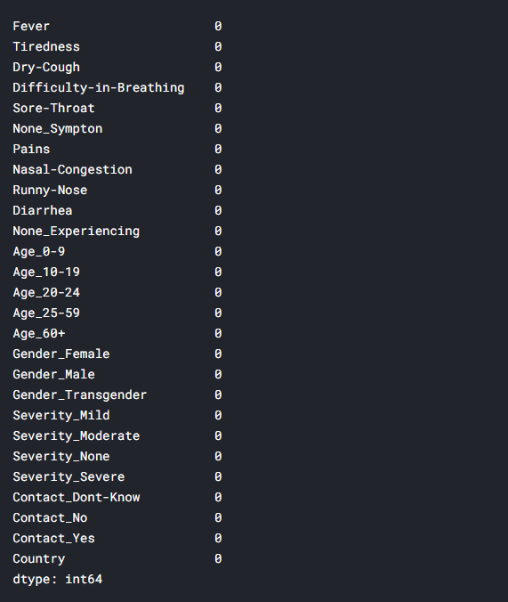
Data Cleaning
Figure 4: Null Value Amounts
This process allows us to fix data entry errors by putting in arbitrary values to satisfy the form
We used weka, python, the pandas library, and numpy library in data cleaning
In our dataset, there weren't any empty values when that we had to put a NULL value for in order to continue with the processing and summarization component (The picture shown was checking the file for null values in python)

Slide 10
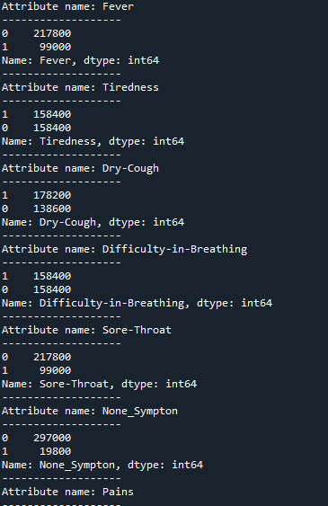
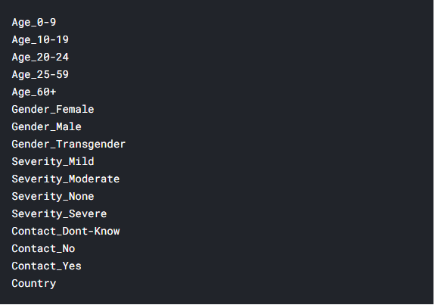
Data Cleaning cont.
After we determined there were no null values we listed the counts of the totals of all the yes’s and no’s in order to determine which attributes were relevant (fig1)
We determined from (fig1) which values were irrelevant attributes (fig2). Age_0-60for example had the same amounts of yes and nos making all the age headers irrelevant.
Figure 5
Figure 6

Slide 11
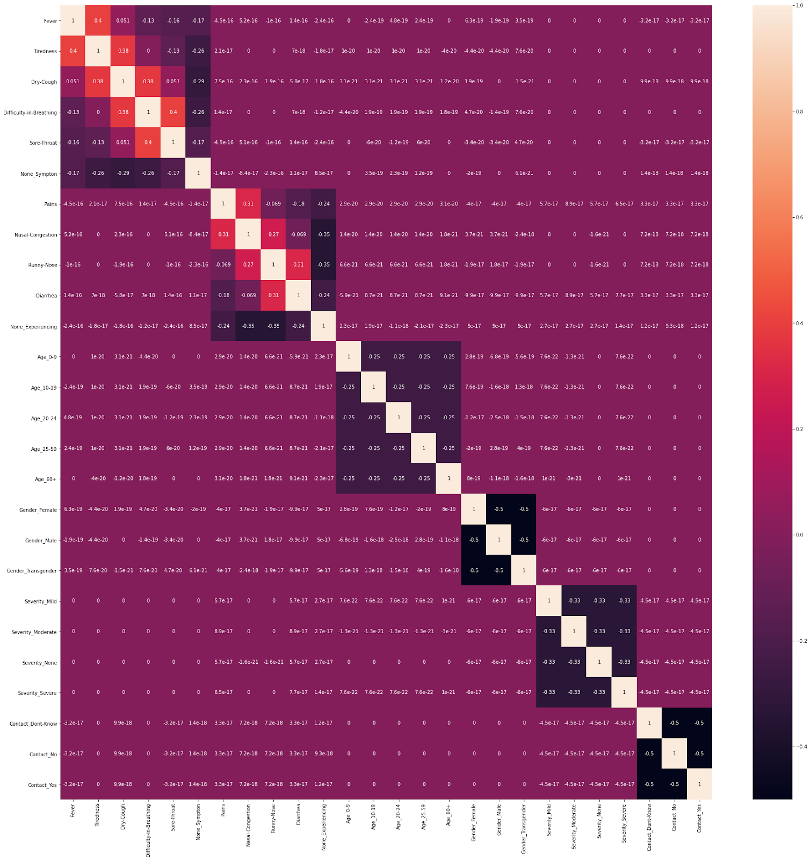
Data Cleaning Conclusion
In hindsight we decided to try and keep the irrelevant attributes of Severity_mild through severe because as we stated, our hypothesis was that we could use the Naive Bayes algorithm with those headers as our labels.
From our slide on Data Transformation, we tried to combine these in order to have it as our label Has-Covid.
This along with our data set being entirely binary led to our model overfitting.
The image on the right is a heat map which we made in python and it also
shows further which attributes are irrelevant.

Slide 12
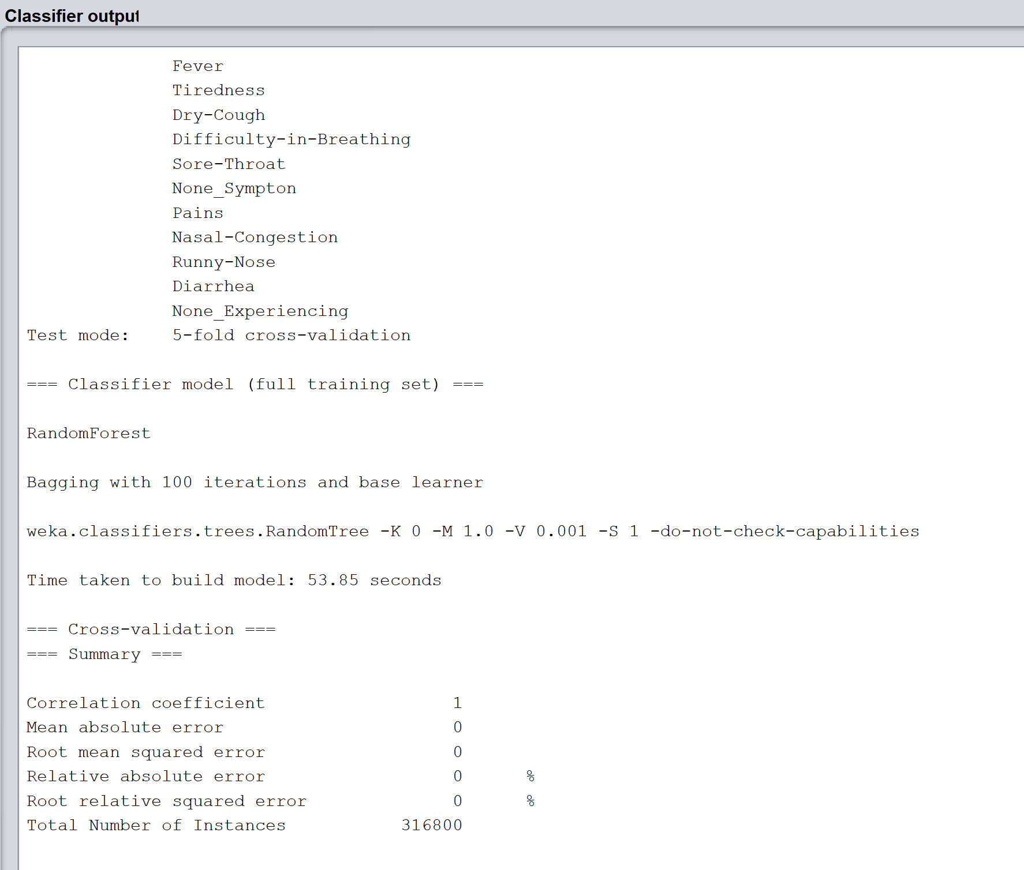
Data Training Phase
When we originally were in the training phase we had used the
Naive Bayes algorithm
Since then we learned that the data should be
implemented with an unsupervised learning
algorithm(image on the right)
Due to our data set being binary both tests
lead to overfitting which is visible from the
error%’s being 0 or near 0%
Figure 8

Slide 13
Mapreduce Processing Technique
Analyze data for each population would cause a dataset to be too large
Need to implement HDFS to be used for synthesis
By using HDFS, the infrastructure is scaled up by adding more racks or clusters to the system

Slide 14
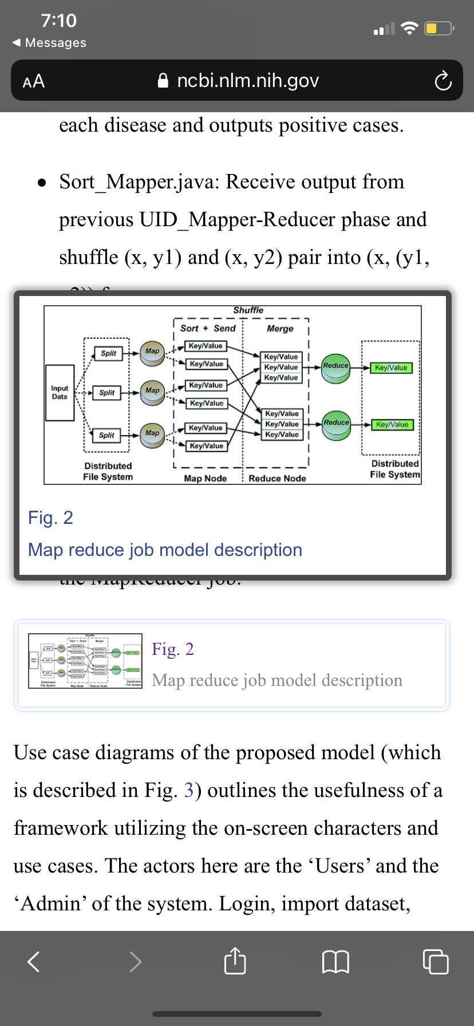
Mapreduce Job Model

Slide 15
Map Phase
Input dataset is processed and generates a key-value pair which is then sent to the reducer for manipulation.
The mapper maps through the rows and sends the cell contents of the 1 or 0 as the key and assigns an intwritable initialized to 1 to the reducer method.
Since we are sending the key with the cell contents and the initial count of 1 for the key the mapper is of type <Object, Text, Text, IntWritable>

Slide 16
Reduce Phase
The reducer receives the key value pair from mapper and from their calculates the frequency of the yes and nos from the columns.
With these frequencies we aggregate those values and calculate the probability of each symptom as such :
The reducer outputs the key of the symptom and a DoubleWritable of the calculated value.

Slide 17
Functionalities of each Program
MapperNB.java: Filters the header and writes to mapper output.
ReducerNB.java: Aggregate values for each disease and outputs positive cases.
SortMapper.java: Receive output from previous Mapper-Reducer phase and shuffle (x, y1) and (x, y2) pair into (x, (y1, y2)) form.
SortComparator.java: Sorts and reduces the output in descending order.
SortReducer.java: Swap (x, y) pair into (disease, count) format and produce output.
DriverNB.java: Main driver program for the MapReducer job.

Slide 18
Expected Results
This proposed research has the ability to segregate out patients with symptoms that include Dry Cough, Runny Nose and Nasal Congestion as a higher risk of severe illness and potentially COVID-19.

Slide 19
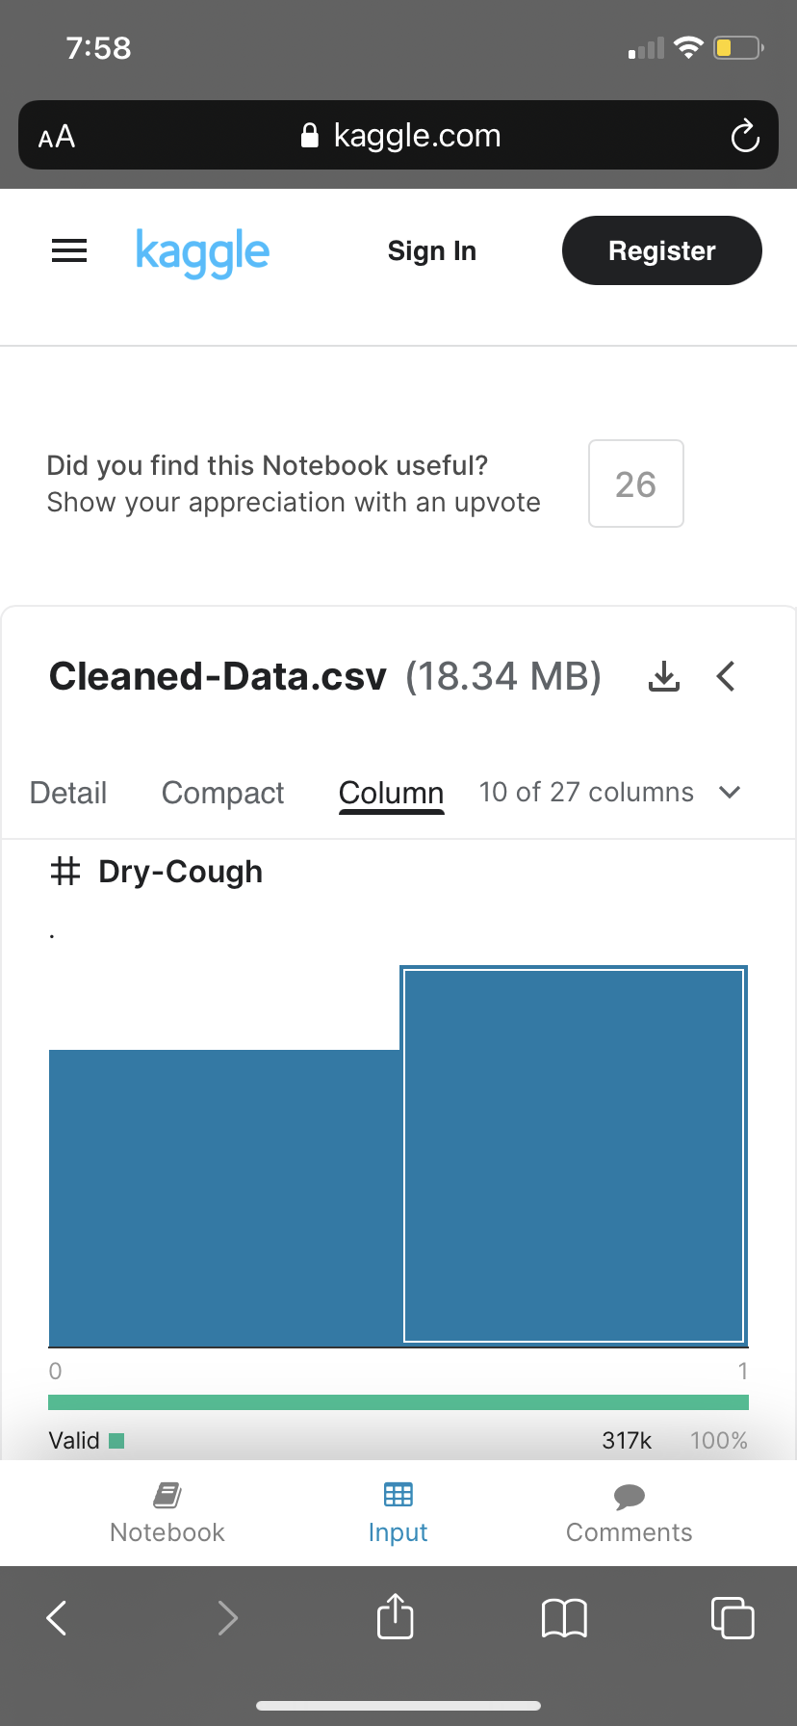
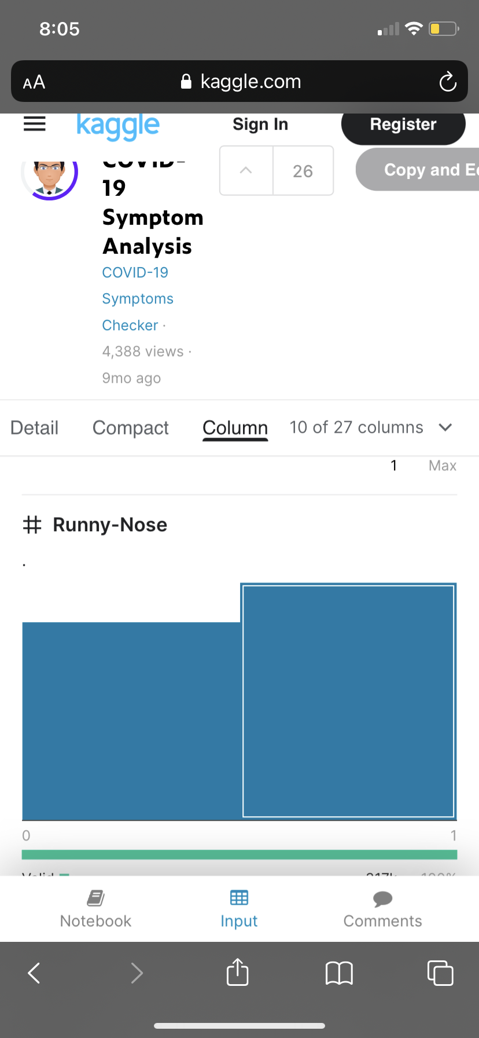
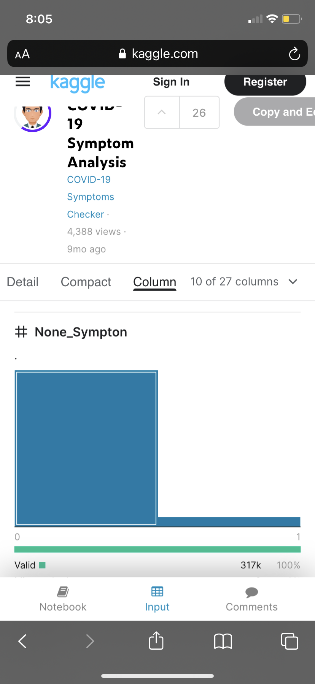
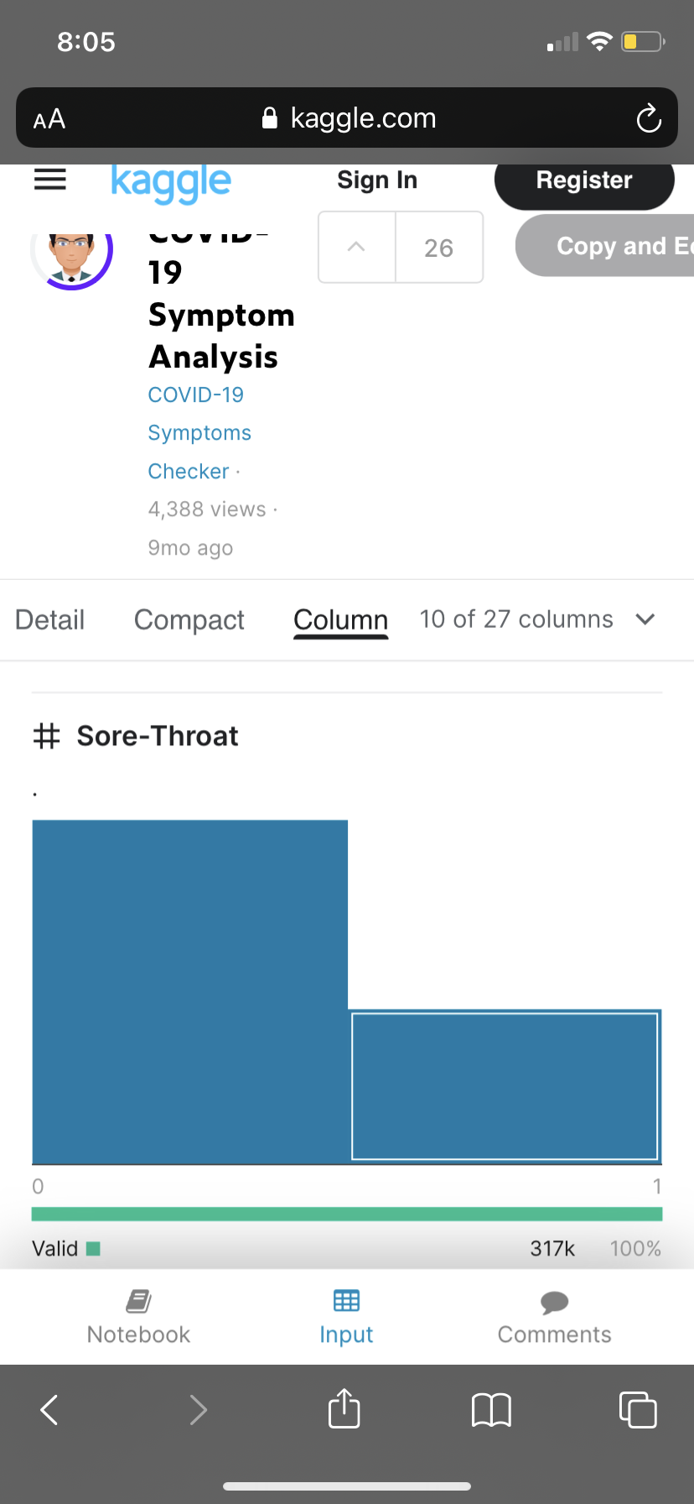
Expected Results Tables
Figure 9: Results of Dry Cough
Figure 10: Results of Runny Nose
Figure 11: Results of Non-symptomatic
Figure 12:Results of Heavy Breathing

Slide 20
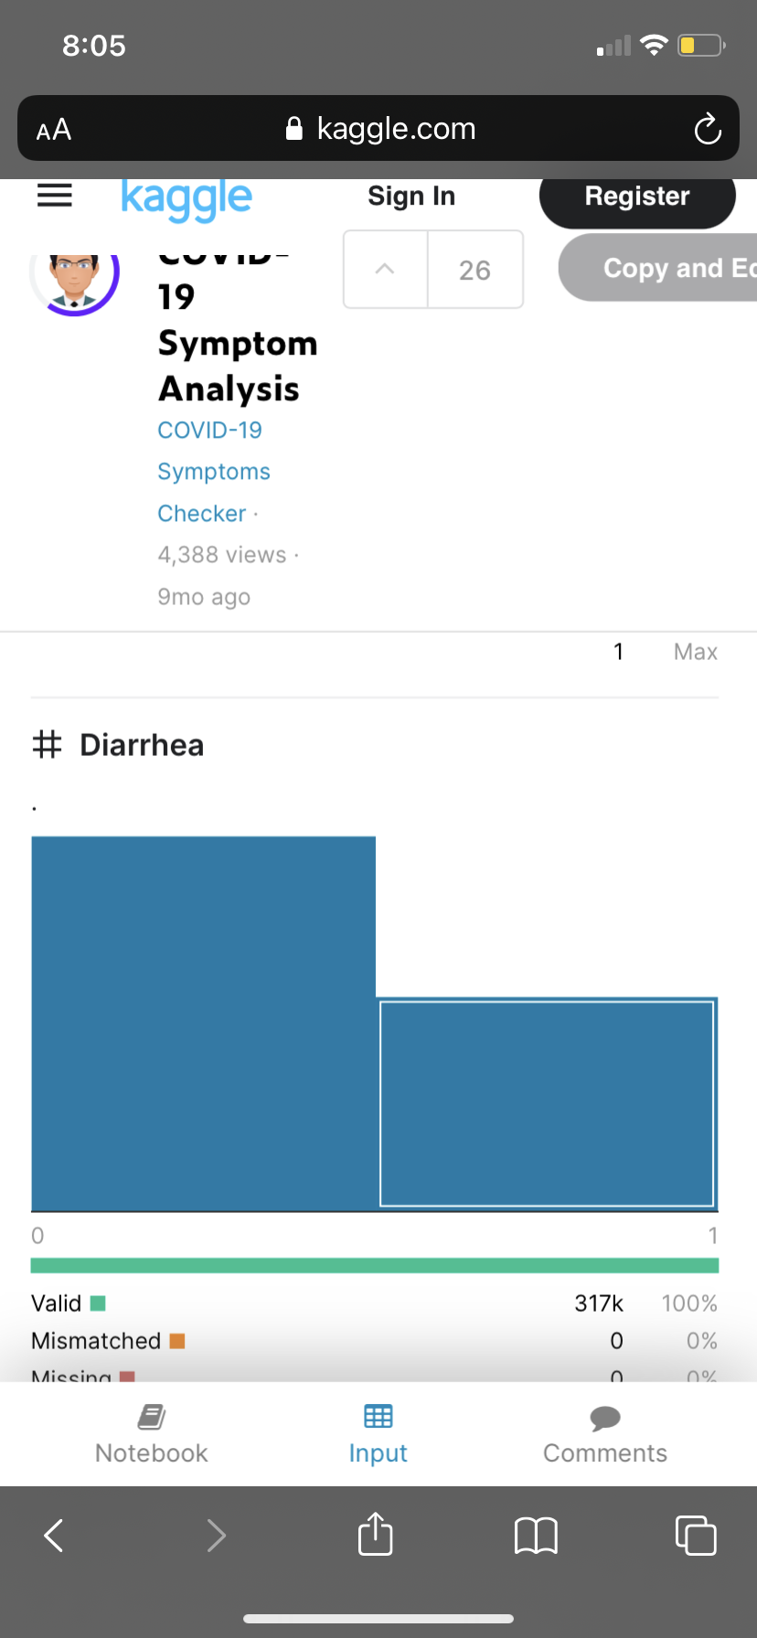
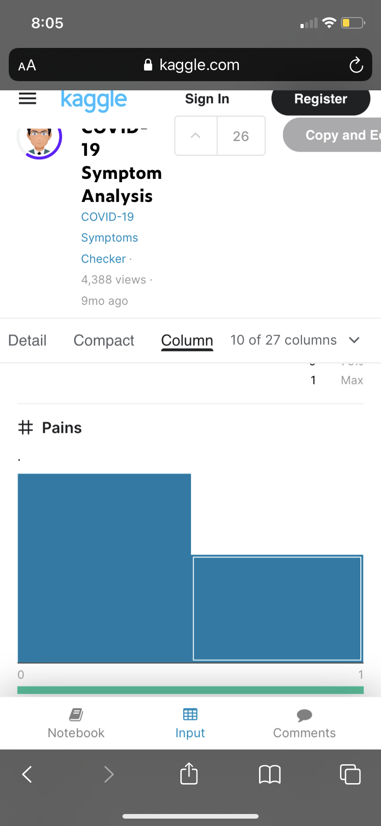
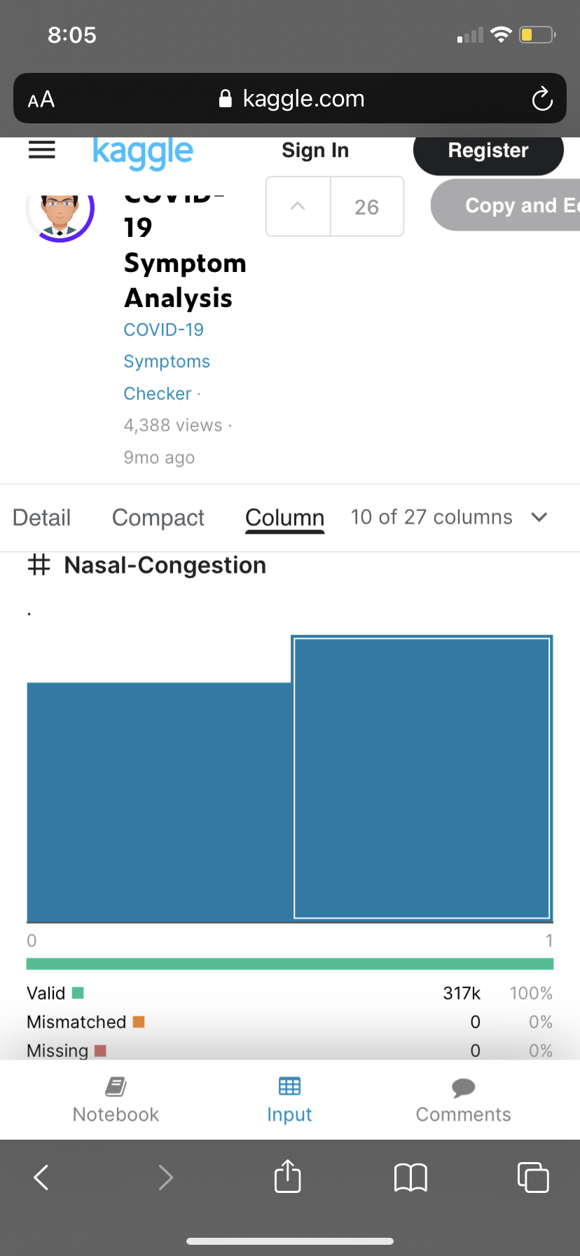
Expected Results Table Continued
Figure 13: Results of Diarrhea
Figure 14: Results of Body Pains
Figure 15: Results of Nasal Congestion

Slide 21
Failures
After cleaning the dataset, we initially wanted to do Naive’s Bayes algorithm for our program
This ended up not working due to our data set being binary which showed a 100% accuracy rate meaning we overfitted our model.
As well as the data set not having a proper label for supervised learning
This ended up making our MapReduce program more difficult to implement as we went along since we realised we had the wrong idea the whole time.
If we were to start over we’d use a more basic data set with either discrete or continuous attributes.
We were very idealistic and wanted to draw conclusions on the COVID-19 pandemic since it is very relevant at this moment.

Slide 22
Conclusions
The objective of this project was to implement a COVID-19 symptom checker which would produce generate if you might have COVID-19 based on your symptoms
We had trouble with the data set we used, and we should've been trying to implement an unsupervised machine learning algorithm instead of a supervised one.
The binary data also made it very confusing to implement our mapreduce program

Slide 23
Conclusion (continued): What We Learned and Improvements
We learned a lot about python and packages like pandas and NumPy with how they are utilized in data science
We also learned about the Apache Hadoop MapReduce programming model with how its classes and methods work.
We also had a better understanding of the algorithms used and when to apply them towards a problem.
It allowed us to have a better appreciation for Data Science as a whole

Slide 24
Work Cited
“COVID-19 Symptoms Checker.” Kaggle, 21 Mar. 2020, www.kaggle.com/iamhungundji/covid19-symptoms-checker.
Harshaggarwal7. “COVID-19 Symptom Analysis.” Kaggle, 6 Aug. 2020, www.kaggle.com/harshaggarwal7/covid-19-symptom-analysis.
“MapReduce Tutorial.” MapReduce Tutorial, 10 Oct. 2020, hadoop.apache.org/docs/r1.2.1/mapred_tutorial.html.
“Susceptibility Analysis of Novel Corona Virus Using Hadoop Distributed File System.” PubMed Central (PMC), 2021, www.ncbi.nlm.nih.gov/pmc/articles/PMC7972300/#!po=2.17391.
Zoabi, Yazeed. “Machine Learning-Based Prediction of COVID-19 Diagnosis Based on Symptoms.” Npj Digital Medicine, 4 Jan. 2021, www.nature.com/articles/s41746-020-00372-6.

